Slide 1

Community Service Day!
AKA: we get to use power tools…
some of us

Slide 2
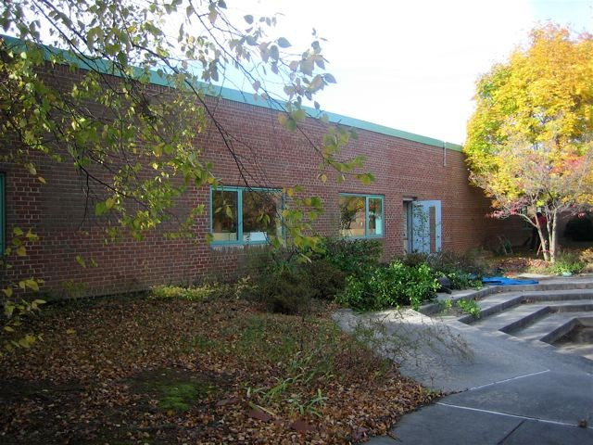
BEFORE…

Slide 3
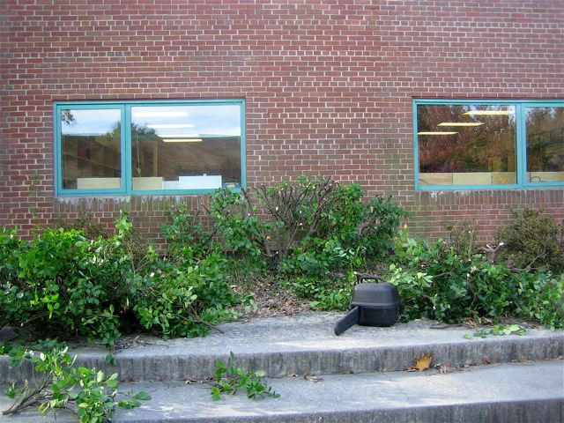
Very still life with Power Tool.

Slide 4
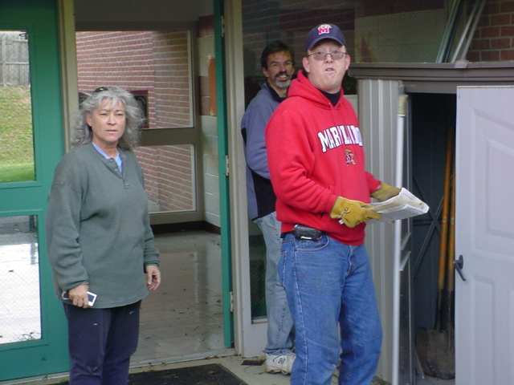
You want us to put WHAT in there?

Slide 5
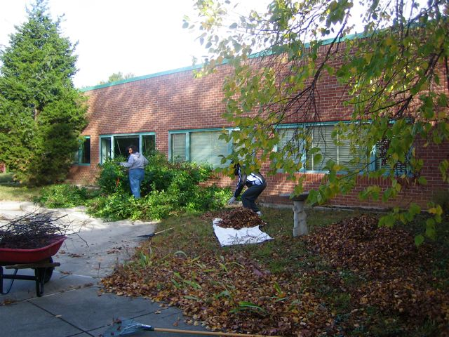
Sheets –To make a bed of leaves! I get it!

Slide 6
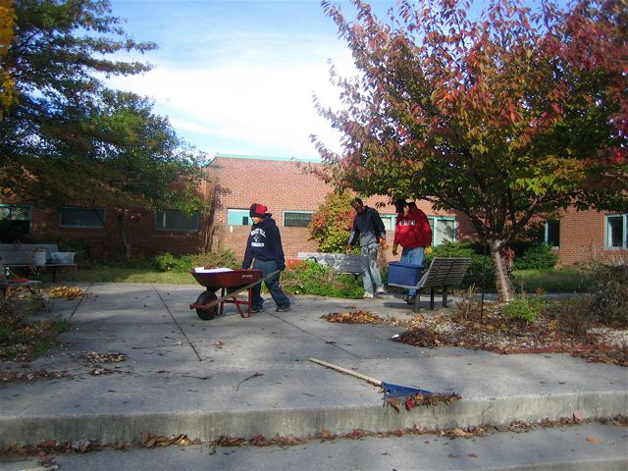
I keep telling them I can do this by myself – but they keep following me all over the place…

Slide 7
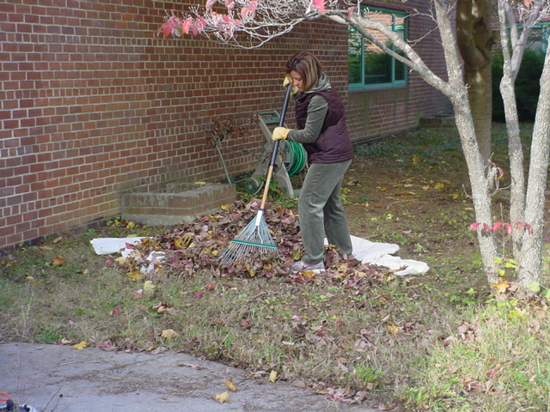
Form: 10
Coordinating Outfit: 10 , woulda’ been a 10+ except for those yellow gloves…

Slide 8
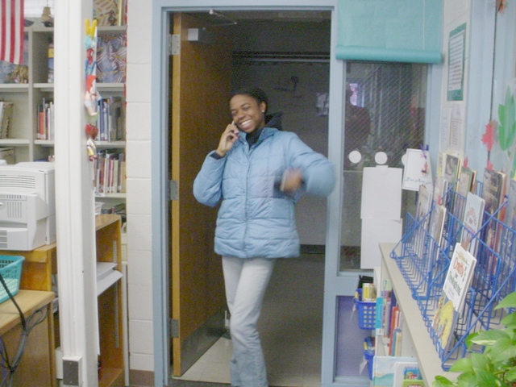
Okay, so, yeah. I’m supposed to be out there raking and stuff….

Slide 9
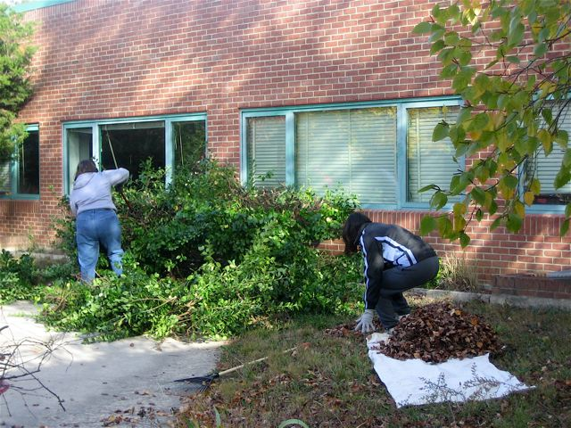
Leslie? Is that you in there?

Slide 10
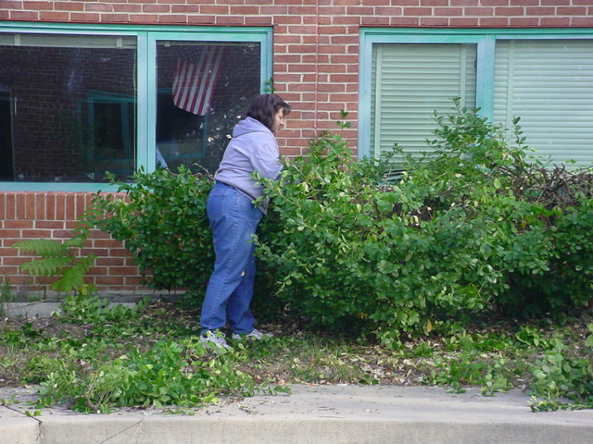
You can stop hiding now, Leslie. I’ll show you how to do this…

Slide 11
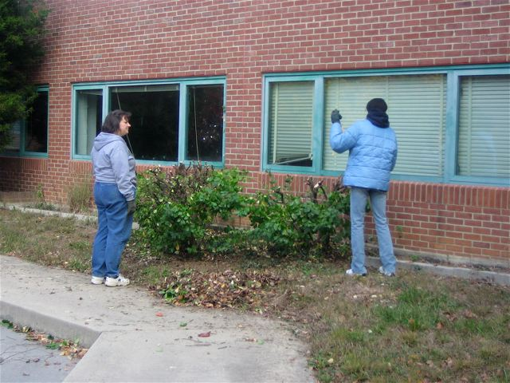
That’s it, Leslie, stretch, pull the rake back towards you, stretch, pull back…

Slide 12
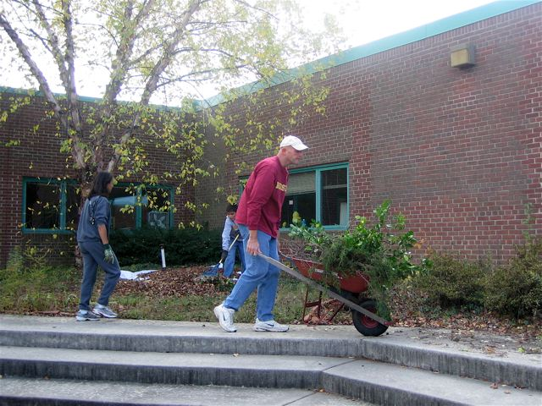
First they tell me they want it over here, now they tell me they want it over there…

Slide 13
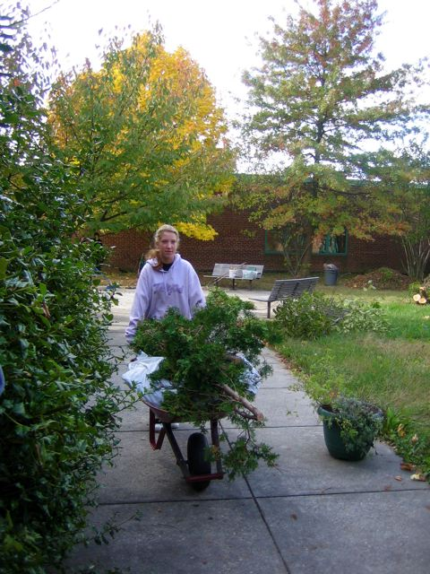
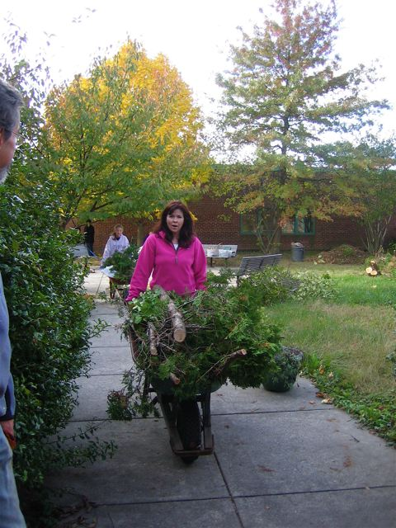
Is it real, or is it Memorex?

Slide 14
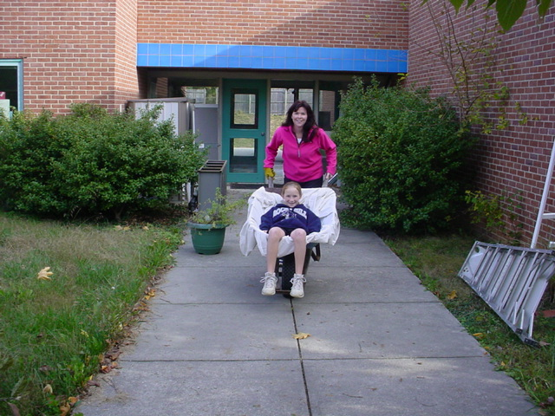
This sure beats lugging branches…

Slide 15
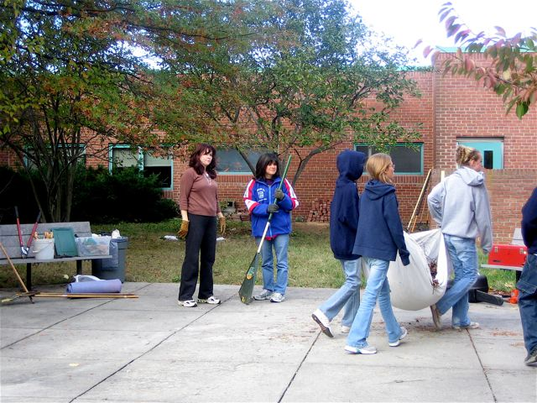
Good supervision is everything.
Oooh, they look cute, didn’t we train them well?

Slide 16
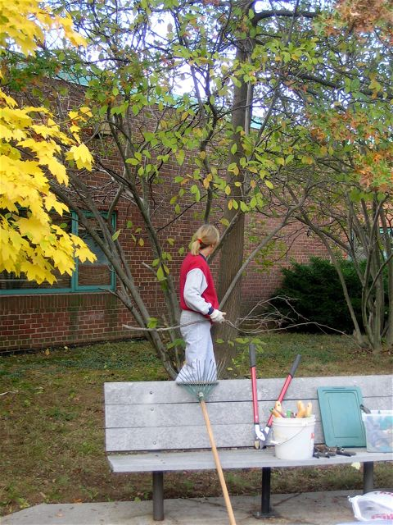
Believe me, you won’t miss this branch. Trust me.

Slide 17
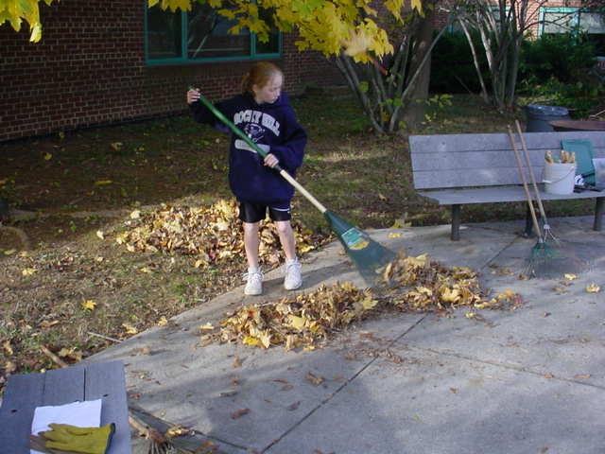
Put one pile over here, then rake it into another pile over there. ..

Slide 18
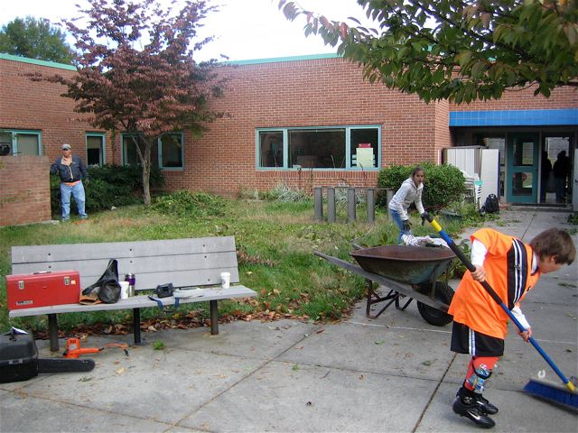
Do the grownups know about the leaves still waiting to fall from those trees?

Slide 19
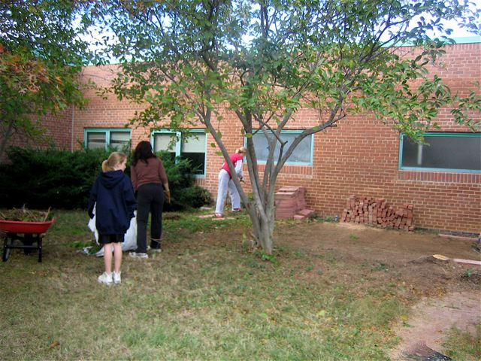
I am not going to admit that wearing shorts was a bad idea. I am not going to admit that wearing shorts was a bad idea…

Slide 20
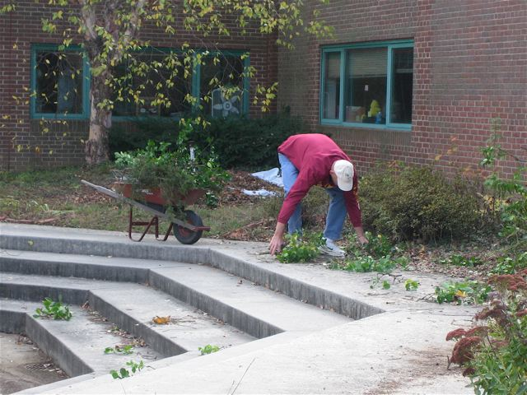
Why won’t this thing move?

Slide 21
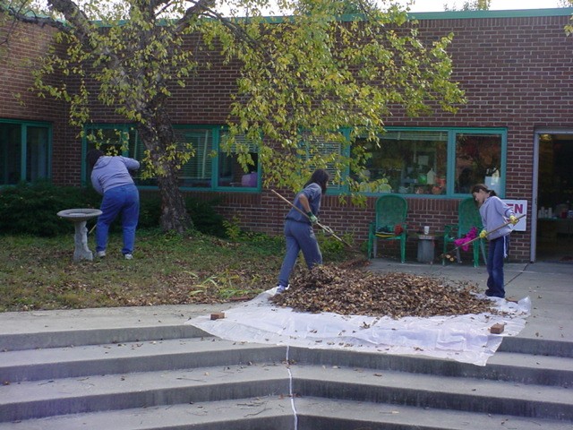
Okay, once we get this sheet full, then what?

Slide 22
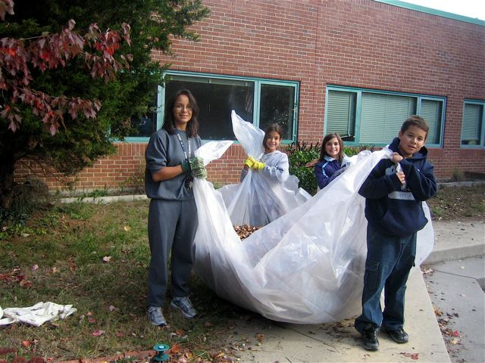
Kids – the instant labor solution.

Slide 23
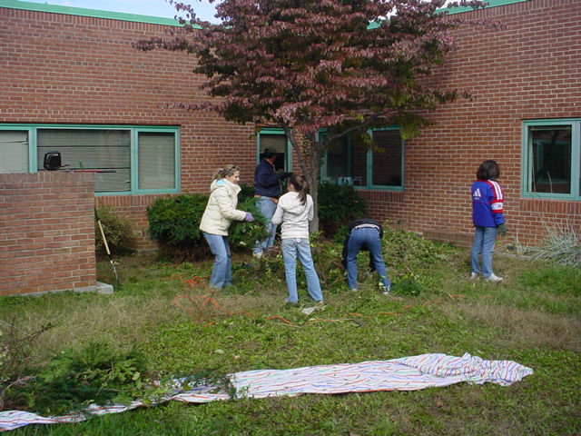
Okay, there’s something weird going on in there…

Slide 24
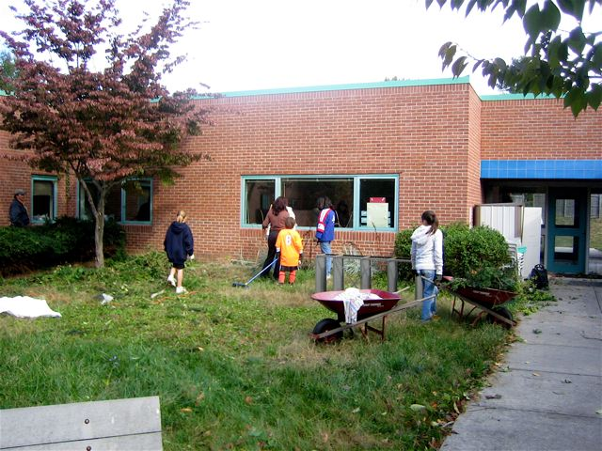
I’m telling you guys, you gotta’ see this…

Slide 25
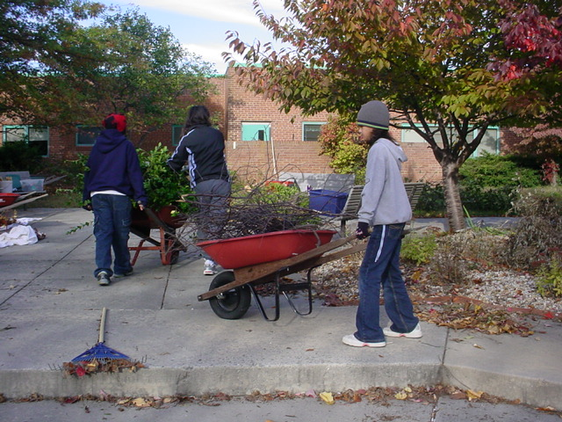
Follow the grownups…I hope they know where they’re going…

Slide 26
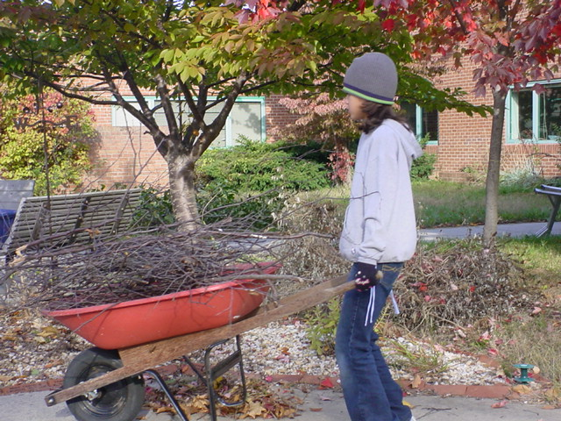
But will they notice if I just move this to the other side of the quad?

Slide 27
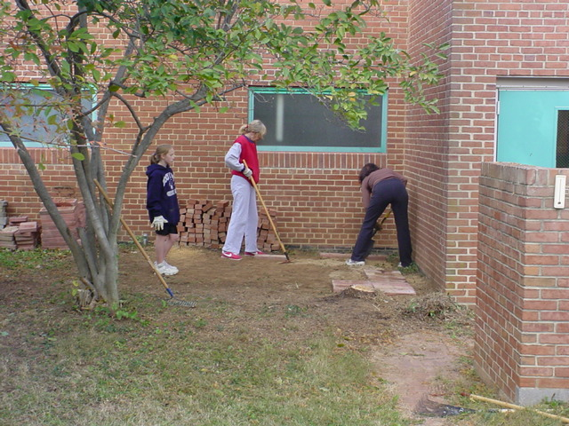
I still think this is a weird place to put a patio. But no one listens to me.

Slide 28
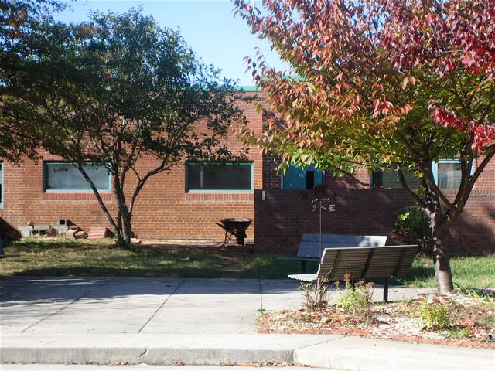
Shed goes here

Slide 29
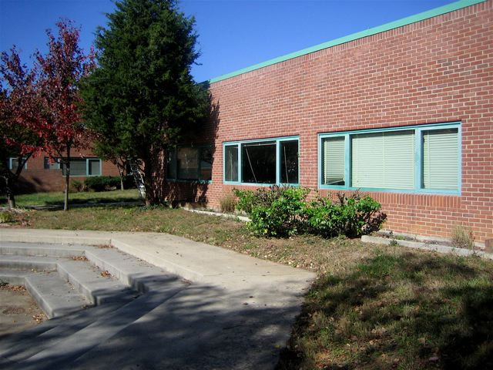
AFTER…

Slide 30
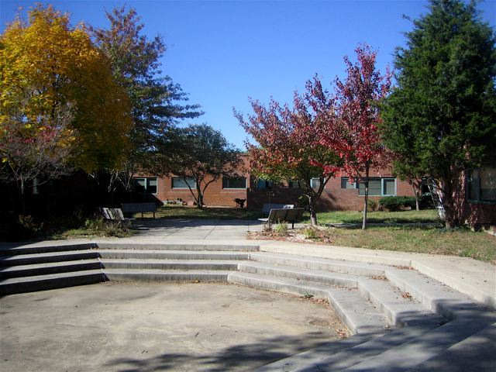
AFTER…

Slide 31
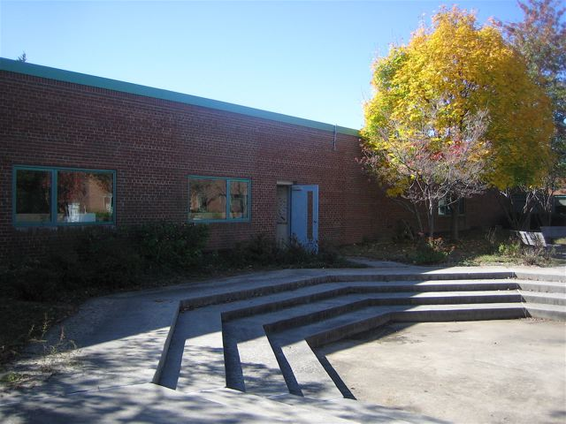
After…with shade.

Slide 32
Thanks for a great job -
Well Done!

Slide 33
With special thanks to Miriam Makeba, Rhino/Warner Bros. Pata, Pata. 2004.

